Slide 1




String Processing
Processing and Manipulating Strings with State Machines and Regex
Advanced
Java
SoftUni Team
Technical Trainers
Software University
http://softuni.bg

Slide 2

Table of Contents
Manipulating Strings
Comparing, Concatenating, Searching
Extracting, Replacing, Deleting Substrings
Using the StringBuilder Class
State Machines
For String Processing
Regular Expressions

Slide 3
Have a Question?
sli.do #JavaFundamentals

Slide 4

Formatting Strings
Basic Format Options

Slide 5
Formatting Strings
String.format() supports common numeric, String, and date/time formats and alignments
Inserting Strings
First argument
Second argument
String result = String.format("%1$s, %2$s!", “Hello”, “World”);
// Hello, World!
result = String.format("%2$s, %1$s!", “Hello”, “World”);
// World, Hello!
Initial symbol
Argument order
Separator
String format specifier

Slide 6
Formatting Strings (2)
Inserting numbers
Padding
Integer format specifier
int number1 = 10;
String value = String.format(“Integer: %1$d", number1); // 10
double number2 = 1.23456;
String value = String.format("Precision 3: %1$.3f", number2); // 1.234
Number precision
Double format specifier
String value = String.format("%1$-10s || %2$10s", 1.26, 5.55);
System.out.println(value);
//1.26 || 5.55
Right padding
Left padding

Slide 7
Problem: Student’s Results
Read a student’s name and results for his courses
Print the results in columns with precision of 2
Calculate his average score with precision of 4
Gosho - 3.33333, 4.4444, 5.555
Name | JAdv | JavaOOP | AdvOOP | Average
Gosho | 3.33 | 4.44 | 5.56 | 4.4442
Check your solution here: https://judge.softuni.bg/Contests/777

Slide 8
Solution: Student’s Results
//TODO: read student’s name and results
System.out.println(
String.format("%1$-10s|%2$7s|%3$7s|%4$7s|%5$7s|",
"Name", "JAdv", "JavaOOP", "AdvOOP", "Average"));
double average =
(results.get(0) + results.get(1) + results.get(2)) / 3;
System.out.println(
String.format("%1$-10s|%2$7.2f|%3$7.2f|%4$7.2f|%5$7.4f|",
name, results.get(0), results.get(1), results.get(2),average));
Check your solution here: https://judge.softuni.bg/Contests/777

Slide 9

Manipulating Strings
Comparing, Concatenating, Searching, Extracting Substrings, Splitting

Slide 10

Trimming Whitespaces and boolean methods
str.trim() – removes all whitespaces at start and end
str.startsWith(String prefix)
str.endsWith(String suffix)
String s = " example of white space ";
String clean = s.trim();
// "example of white space"
String s = "C# is the best!";
boolean startsWithJava = s.startsWith(“Java");
System.out.println(startsWithJava); // false
String s = "How are you?";
boolean isQuestion = s.endsWith("?");
System.out.println(isQuestion); // true

Slide 11

Searching in Strings
Finding a character or substring within a given String
str.indexOf(String/char term) – returns the index of the first occurrence of term in str
Returns -1 if there is no match
str.lastIndexOf(String/char term) – returns the index of the last occurrence of term in str
String email = "vasko@gmail.org";
int firstIndex = email.indexOf("@gmail.org"); // 5
int noIndex = email.indexOf('@', 6); // -1
String verse = "To be or not to be..";
int lastIndex = verse.lastIndexOf("be"); // 16

Slide 12
Extracting Substrings
str.substring(int startIndex, int endIndex)
str.substring(int startIndex)
String filename = "C:\\Pics\\Rila2017.jpg";
String name = filename.substring(8, 16);
// name is Rila2017
String filename = "C:\\Pics\\Rila2017.jpg";
String nameAndExtension = filename.substring(8);
// nameAndExtension is Summer2017.jpg
0 | 1 | 2 | 3 | 4 | 5 | 6 | 7 | 8 | 9 | 10 | 11 | 12 | 13 | 14 | 15 | 16 | 17 | 18 | 19
C | : | \ | P | i | c | s | \ | R | i | l | a | 2 | 0 | 1 | 7 | . | j | p | g

Slide 13
Splitting Strings
To split a String by given separator(s) use the following method:
Single separator
Multiple separators
String line = “Carrot:Orange,Apple:Red";
String[] vegetables = line.split(",");
Carrot
Orange
Apple
Red
String line = “Carrot:Orange,Apple:Red"; String[] vegetables = line.split("[,:]");

Slide 14
Problem: Parse URL
Write a program that parses an URL address given in the format:
[protocol]://[server]/[resource]
Extract protocol, server and resource
https://softuni.bg/trainings/1531/java-advanced-january-2017
Protocol = https
Server = softuni.bg
Resources = trainings/1531/java-advanced-january-2017
Check your solution here: https://judge.softuni.bg/Contests/777

Slide 15


Solution: Parse URL
String[] reminder = input.split("://");
String protocol = reminder[0];
int serverEndIndex = reminder[1].indexOf("/");
String server = reminder[1].substring(0, serverEndIndex);
String resource = reminder[1].substring
(serverEndIndex + 1, reminder[1].length() - 1);
URL
Check your solution here: https://judge.softuni.bg/Contests/777

Slide 16


Changing Character Casing
Using the method toLowerCase()
Using the method toUpperCase()
String alpha = "aBcDeFg";
String lowerAlpha = alpha.toLowerCase();
System.out.println(lowerAlpha);
// abcdefg
String alpha = "aBcDeFg";
String upperAlpha = alpha.toUpperCase(); System.out.println(upperAlpha);
// ABCDEFG

Slide 17
Replacing substrings
str.replace(CharSequence tar, CharSequence rep) – replaces all occurrences of a given String with another
str.replaceFirst(String str, String rep) – replaces only the first match of a given String with another
String cocktail = "Vodka + Martini + Cherry"; String replaced = cocktail.replace("+", "and"); // Vodka and Martini and Cherry
String str = "My number is: +123123123";
String newStr = str.replaceFirst("12", "9");
// My number is: +93123123

Slide 18

Problem: Parse Tags
Write a program that changes the text in all regions surrounded by the tags <upcase> and </upcase> to upper-case.
The tags cannot be nested.
We are living in a <upcase>yellow submarine</upcase>.
We don't have <upcase>anything </upcase> else.
We are living in a YELLOW SUBMARINE.
We don't have ANYTHING else.
Check your solution here: https://judge.softuni.bg/Contests/777

Slide 19
Solution: Parse Tags
//TODO: Read text
while (input.contains(upcaseStart)) {
int startIndex = input.indexOf(upcaseStart);
int endIndex = input.indexOf(upcaseStop);
String reminder = input.substring(startIndex + 8);
String upReminder = reminder.toUpperCase();
input = input.replaceFirst(reminder, upReminder);
input = input.replaceFirst(upcaseStart, "");
input = input.replaceFirst(upcaseStop, "");
}
//TODO: Write modified text
Check your solution here: https://judge.softuni.bg/Contests/777

Slide 20

Comparing Strings
Difference between == and .equals()

Slide 21


Comparing Strings
Equality checking by operator ==
WARNING! Compares references, not the content of the Strings
Using the equals() and equalsIgnoreCase() method
Unlike the operator == these methods compare Strings by their value
if (str1 == str2) {
…
}
if (str1.equals(str2)) {
…
}

Slide 22

Comparing Strings (2)
Dictionary-based String comparison
Case-sensitive
Case-insensitive
int result = str1.compareTo(str2);
int result = str1.compareToIgnoreCase(str2);
// result == 0 if str1 equals str2
// result < 0 if str1 is before str2
// result > 0 if str1 is after str2

Slide 23

Concatenating and Building Strings
Using the StringBuilder Class

Slide 24

Concatenating Strings
There are two ways to combine Strings:
Using the concat() method
Using the + or the += operators
Any object can be appended to a String
String str = str.concat(strToConcat);
String str = str1 + str2 + str3;
String str += str1;
String name = "Peter";
int age = 22;
String s = name + " " + age; // → "Peter 22"

Slide 25
Changing the Contents of a String
Use the java.lang.StringBuilder class for modifiable Strings of characters:
Use StringBuilder if you need to keep adding characters to a String or when you have to print to the console many times
public static String reverseString(String s) { StringBuilder sb = new StringBuilder(); for (int i = s.length() - 1; i >= 0; i--) { sb.append(s.charAt(i)); } return sb.toString(); }

Slide 26
StringBuilder: How It Works?
Capacity
StringBuilder:
length() = 9
capacity() = 25
Y | o | , |  | J | a | v | a | !
used buffer
(Length)
unused buffer
StringBuilder keeps a buffer memory, allocated in advance
Most operations use the buffer memory and do not allocate new objects
Using StringBuilder is faster than simple String concatenation

Slide 27
The StringBuilder Class
insert(int index, String str) - inserts a String at a certain index
delete(int startIndex, int endIndex) removes a substring within two indexes.
StringBuilder sb = new StringBuilder("123456");
sb.insert(3, "pass");
System.out.println(sb); //123pass456
Accepts all primitive types and char[]
StringBuilder sb = new StringBuilder("123pass456");
sb.delete(3, 7);
System.out.println(sb); //123456
Exclusive the last index

Slide 28
StringBuilder Class (2)
.replace(int startInd, int endInd, String str)
.reverse() - replaces a String by a reversed copy of it.
StringBuilder sb = new StringBuilder("123pass456");
sb.replace(3, 7, "woo");
System.out.println(sb); //123woo456
StringBuilder sb = new StringBuilder("123456");
sb.reverse();
System.out.println(sb); //654321

Slide 29



Practice: String Manipulations
Live Exercises in Class (Lab)

Slide 30
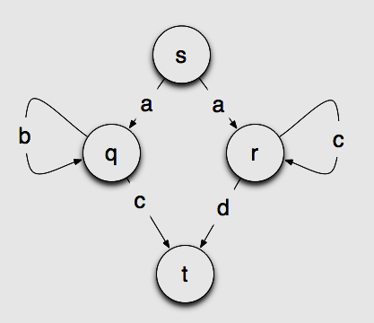
State Machines
Real life examples of a state machine

Slide 31
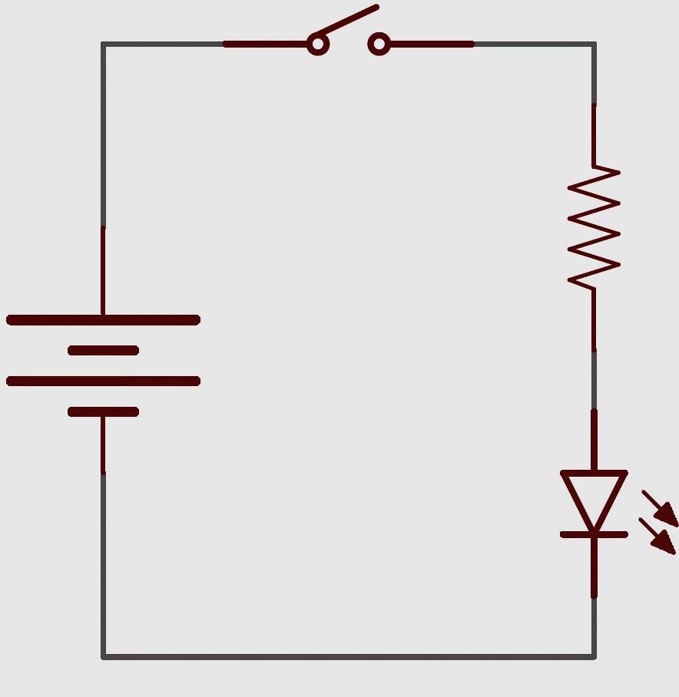

State Machine
Conceptual model used to describe how things work
Every time it reads an input it will switch to a different state
Only one state can be active at the same time
Each state specifies which state to switch next
A Lightbulb is real life example of a state machine

Slide 32
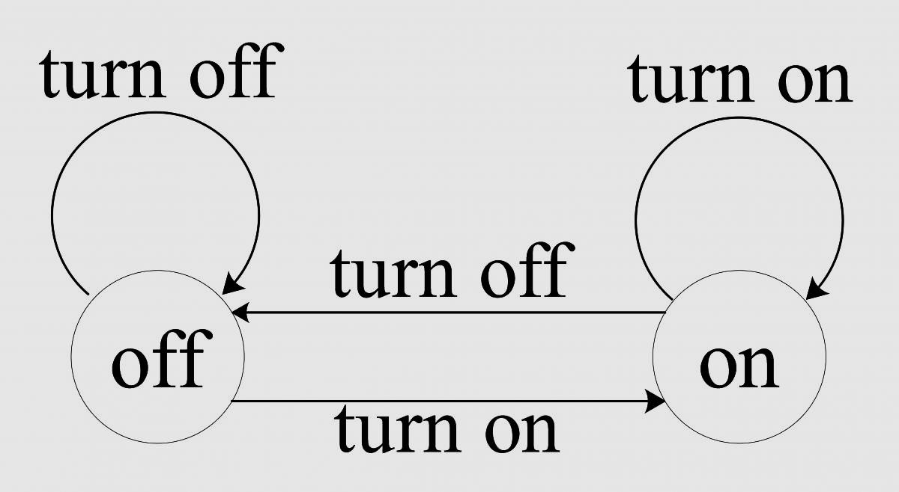

Example of a Finite State Machine (FSM)
We can return to previous state
Pressing OFF changes nothing
Finite = limited
number of states available
Start state - OFF
Pressing ON changes the current state

Slide 33
State Machine for String Processing
Powerful tool for String processing
r
a
m
P
i
o
g
n
Initial state
Final state
P | r | o | g | r | a | m | m | i | n | g

Slide 34
State Machine for String Processing (2)
int state = 0;
int i = 0;
while (i <= input.length) {
switch (state) {
case 0: //Initial state
if (input[i] == 'p' || input[i] == 'P') state = 1;
else state = -1;
break;
case 1: // P or p
if (input[i] == 'r') state = 2;
else state = -1;
break;
case 2: // r
if (input[i] == 'o') state = 3;
else if (input[i] == 'a') state = 5;
else state = -1;
break;
The initial state is always reached
Multiple transitions from a state are possible

Slide 35
State Machine for String Processing (3)
case 3: // o
if (input[i] == 'g') state = 4;
else state = 10;
break;
case 4: // g
if (i == 11) { //End state
System.out.println("Word is valid"); return;
else if (input[i] == 'r') state = 2;
else state = -1;
break;
case 5: // a
if (input[i] == 'm') state = 6;
else state = -1;
break;
There is a case for each state
If the final state is reached – the word is valid

Slide 36
State Machine for String Processing (4)
case 6: // m
if (input[i] == 'm') break;
else if (input[i] == 'i') state = 7;
else state = -1;
break;
case 7: // i
if (input[i] == 'n') state = 8;
else state = -1;
break;
case 8: // n
if(input[i] == 'g') state = 4;
else state = -1;
break;
default:
System.out.println("The word is not valid");
break;
} ++i; }
The default case handles invalid input

Slide 37
Problem: Series of Letters
Read a String from the console
Replace series of consecutive identical letters with a single one
Solve the problem building your own state machine
bookkeeper
tattoo
bokeper
tato
Check your solution here: https://judge.softuni.bg/Contests/777

Slide 38
Series of Letters: Solution with FSM
int state = 0; char prev = input[0];
for (int i = 0; i < input.length; i++){
switch (state){
case 0: //Initial state
state = 1;
prev = input[i]; break;
case 1: // Found a new letter
output.append(prev);
if (input[i] == prev)
state = 2;
prev = input[i]; break;
Check your solution here: https://judge.softuni.bg/Contests/777

Slide 39
Series of Letters: Solution with FSM (2)
case 2: // Found the same letter
if (input[i] != prev)
state = 1;
prev = input[i]; break;
}
if(input[i-2] != prev)
output.append(prev);
System.out.println(output)
Check your solution here: https://judge.softuni.bg/Contests/777

Slide 40
Regular Expressions
(?<=\.) {2,}(?=[A-Z])
Using RegEx in Java

Slide 41
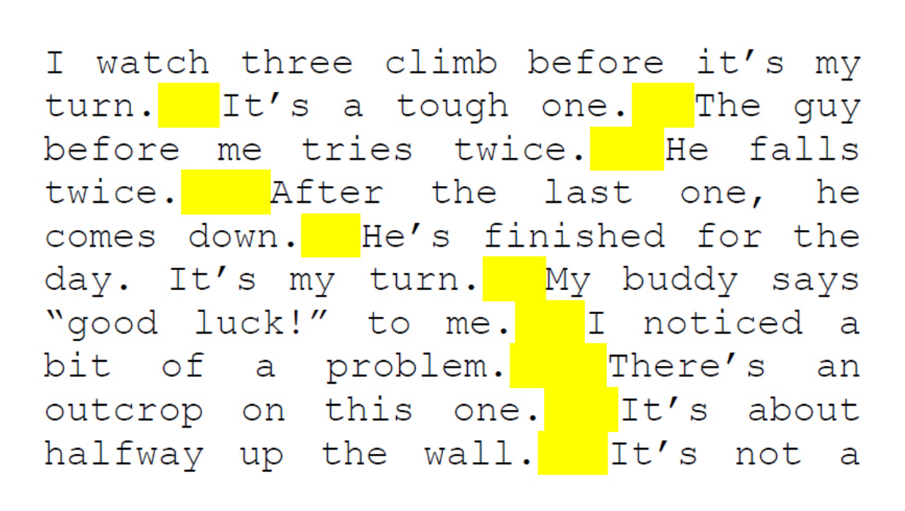
Regular Expressions
Sequence of characters that forms a search pattern
Used for finding and matching certain parts of strings
Most common application of a finite state machine
(?<=\.) {2,}(?=[A-Z])

Slide 42
Regex in Java
Regex in Java library
java.util.regex.Pattern
java.util.regex.Matcher
Pattern pattern = Pattern.compile("a*b");
Matcher matcher = pattern.matcher("aaaab");
boolean match = matcher.find();
String matchText = matcher.group();
Searches for the next match
Gets the matched text

Slide 43
Validating String By Pattern
Pattern.matches(String pattern, String text) – determines whether the text matches the pattern
String text = "Today is 2015-05-11";
String pat = "\\d{4}-\\d{2}-\\d{2}";
boolean containsValidDate =
Pattern.matches(pat, text);
System.out.print(containsValidDate); // true
Shorthand for [0-9]

Slide 44
Checking for a Single Match
find() - Gets the first pattern match
Matches the element one or more times
String text = "Andy: 123";
String pattern = "([A-Z][a-z]+): (\\d+)";
Pattern regex = Pattern.compile(pattern);
Matcher matcher = regex.matcher(text);
matcher.find();
Group 0 = Andy: 123
Group 1 = Andy Group 2 = 123

Slide 45
Splitting With Regex
split(String pattern) – splits the text by the pattern
Returns String[]
Matches whitespaces
String text = "1 2 3 4";
String pattern = "\\s+";
String[] tokens = text.split(pattern);
tokens = { "1", "2", "3", "4" }

Slide 46
Series of Letters: Solution with RegEx
public static void main(String[] args) {
Scanner scanner = new Scanner(System.in);
String input = scanner.nextLine();
String pattern = "([a-zA-Z ])\\1*";
Pattern regex = Pattern.compile(pattern);
Matcher matcher = regex.matcher(input);
while (matcher.find()) {
System.out.print(matcher.group(1));
}
}
Matches the value of group 1
Check your solution here: https://judge.softuni.bg/Contests/777

Slide 47
Helpful Resources
https://regex101.com and http://regexr.com – websites to test Regex using different programming languages
http://docs.oracle.com/javase/7/docs/api/java/util/regex/Matcher – a quick reference for Regex from Oracle
http://regexone.com – interactive tutorials for Regex
http://www.regular-expressions.info/tutorial.html – a comprehensive tutorial on regular expressions

Slide 48
Problem: Vowel Count
Find the count of all vowels in a given text
vowels are upper and lower a, e, i, o, u and y
Vowels: 5
Abraham Lincoln
In 1519 Leonardo da Vinci died at the age of 67.
Vowels: 15
Check your solution here: https://judge.softuni.bg/Contests/777

Slide 49
Solution: Vowel Count
String text = reader.readLine();
Pattern pattern = Pattern.compile("[AEIOUYaeiouy]");
Matcher matcher = pattern.matcher(text);
int count = 0;
while (matcher.find())
count++;
System.out.println("Vowels: " + count);
Check your solution here: https://judge.softuni.bg/Contests/777

Slide 50
Problem: Extract Tags
Extract all tags from a given HTML
Read until an END command
<!DOCTYPE html>
<html lang="en">
<head>
<meta charset="UTF-8">
<title>Title</title>
</head>
</html>
END
<!DOCTYPE html>
<html lang="en">
<head>
<meta charset="UTF-8">
<title>
</title>
</head>
</html>
Check your solution here: https://judge.softuni.bg/Contests/777

Slide 51
Solution: Extract Tags
Pattern pattern = Pattern.compile("<.*?>");
String text = reader.readLine();
while (!text.equals("END")) {
Matcher matcher = pattern.matcher(text);
while (matcher.find())
System.out.println(matcher.group());
text = reader.readLine();
}
Matches the element zero or one times
Check your solution here: https://judge.softuni.bg/Contests/777

Slide 52
Problem: Valid Usernames
Scan through the lines for valid usernames:
Has length between 3 and 16 characters
Contains letters, numbers, hyphens and underscores
Has no redundant symbols before, after or in between
sh
too_long_username
!lleg@l ch@rs
jeff_butt
END
invalid
invalid
invalid
valid
Check your solution here: https://judge.softuni.bg/Contests/777

Slide 53
Solution: Valid Username
Match must start at the beginning of the string
Pattern pattern =
Pattern.compile("^[a-zA-Z0-9_-]{3,16}$");
String text = reader.readLine();
while (!text.equals("END")) {
Matcher matcher = pattern.matcher(text);
if (matcher.find())
System.out.println("valid");
else
System.out.println("invalid");
text = reader.readLine();
}
Match must occur at the end of the string
Check your solution here: https://judge.softuni.bg/Contests/777

Slide 54

Practice: State Machines and Regex
Exercises in class

Slide 55
Summary
Strings are immutable sequences of
chars (instances of java.lang.String)
Can’t be iterated
Support operations such as substring(),
indexOf(), trim(), etc.
Changes to the String create a new object, instead of modifying the old one
StringBuilder offers good performance
Recommended when concatenating Strings in a loop

Slide 56
Summary (2)
State machines describe how things work
Often used for String processing
Regular expressions describe patterns for
searching through text
They define special characters, operators and constructs
Powerful tool for extracting or validating data
Java provides a built-in RegEx classes

Slide 57







String Processing
https://softuni.bg/courses/

Slide 58





Trainings @ Software University (SoftUni)
Software University – High-Quality Education, Profession and Job for Software Developers
softuni.bg
Software University Foundation
http://softuni.foundation/
Software University @ Facebook
facebook.com/SoftwareUniversity
Software University Forums
forum.softuni.bg

